Slide 1
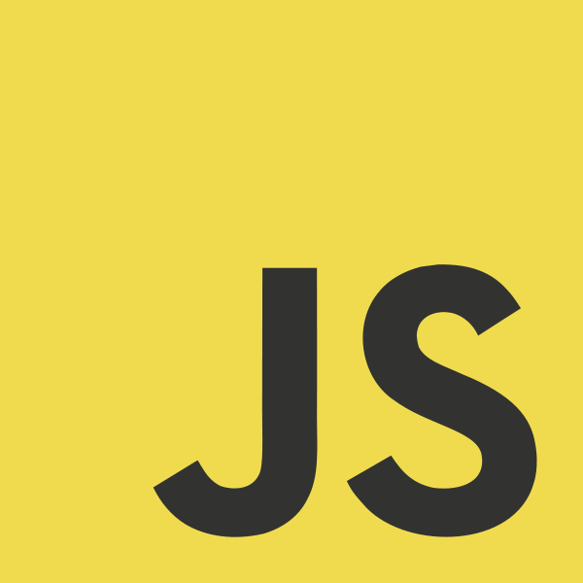
JavaScript

Slide 2
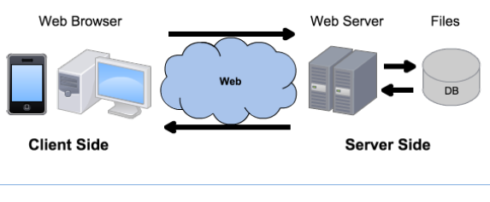
Linux
Windows
MacOS
Android
Linux
Windows Server
DEPLOYMENT
Apache
Tomcat
IIS
NodeJS
MySQL
Oracle
SQL Server
MongoDB
Chrome
Firefox
Safari
ARCHITECTURE
HTTP
HTTPS
HTML
CSS
JavaScript
PHP
Java
ASP
JavaScript
SQL
JSON
DEVELOPMENT
Notepad++
Eclipse
Visual Studio

Slide 3
What is JavaScript?
JavaScript is a dynamic / scripting language
A high-level language that executes many behaviours at runtime
static languages perform them during compilation
For example, it is dynamically typed
At runtime, the system merely checks that a variable supports all of the operations performed on it
TypeScript is a strict syntactical superset of JavaScript, and adds optional static typing to the language
Originally only executed client-side, by the web browser
As opposed to server-side (on the web server)
Currently, Node.js allows you to run JavaScript on the server
Some databases, like MongoDB and CouchDB, also use JavaScript
JavaScript is not part of the Java platform

Slide 4
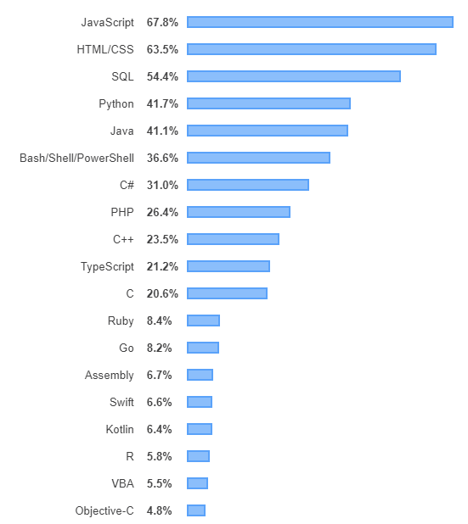
JavaScript is #1
https://insights.stackoverflow.com/survey/2019#most-popular-technologies

Slide 5
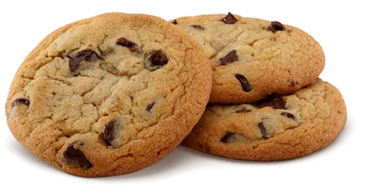
What Does JavaScript Do?
Displays interactive content
Performs animations of page elements
Validates input values from a form before submitting them to the server
Loads new page content or submits data to the server, via AJAX, without reloading the page
Transmits information about the user's browsing activities
web analytics, ad tracking, personalization…

Slide 6
Limitations
Script code is embedded in the webpage, viewable to the world.
For security reasons, scripts are limited in what they can do:
e.g., can't access the client's hard drive directly (has to go through the browser)
Since it is designed to run on any machine, scripts do not contain platform-specific commands.
The user can block JavaScript, so input validation must be performed on the server-side as well.

Slide 7
JavaScript Essentials
JavaScript is Case Sensitive
// single-line comment
/* multi-
-line
comment */
JavaScript Can Change HTML Content, Attributes, Styles
JavaScript Can Hide/Show HTML Elements

Slide 8
The <script> Tag
To insert a JavaScript into an HTML page, use the <script> tag.
The <script> and </script> tells where the JavaScript starts and ends.
The lines between the <script> and </script> contain the JavaScript.
You can place an unlimited number of scripts in an HTML document.
Scripts can be placed in the <body> and/or in the <head> section of an HTML page

Slide 9
External JavaScripts
Scripts can also be placed in external files, to be used by several different web pages. The files have the extension .js
To use an external script, point to the .js file in the "src" attribute of the <script> tag:
<!DOCTYPE html> <html> <body> <script src="myScript.js"></script> </body> </html>
Do not declare <script> again in the external .js file
External scripts can be referenced with a full URL or with a path relative to the current web page
<script src="http://www.w3schools.com/js/myScript1.js"></script>

Slide 10
Manipulating HTML Elements
To access an HTML element from JavaScript, you can use the document.getElementById(id) method.
The innerHTML property defines the HTML content
<!DOCTYPE html>
<html>
<body>
<h1>My First Web Page</h1>
<p id="demo">My First Paragraph.</p>
<script>
document.getElementById("demo").innerHTML="My First JavaScript";
</script>
</body>
</html>

Slide 11
Variables
The assignment operator (=) assigns a value to a variable
You declare JavaScript variables with the var keyword:
var carname = "Volvo";
You can declare many variables in one statement. Just start the statement with var and separate the variables by comma:
var lastname = "Doe", age = 30, job = "carpenter";
A variable declared without a value will have the value undefined.
If you re-declare a JavaScript variable, it will not lose its value.
If you assign a value to a variable that has not yet been declared, the variable will automatically be declared as a GLOBAL variable.
Avoid using global vars, as they can be overwritten by other scripts

Slide 12
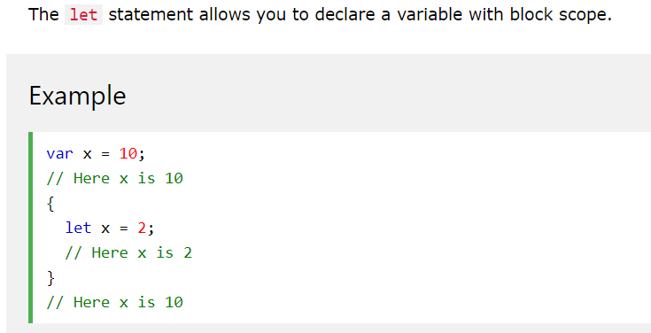
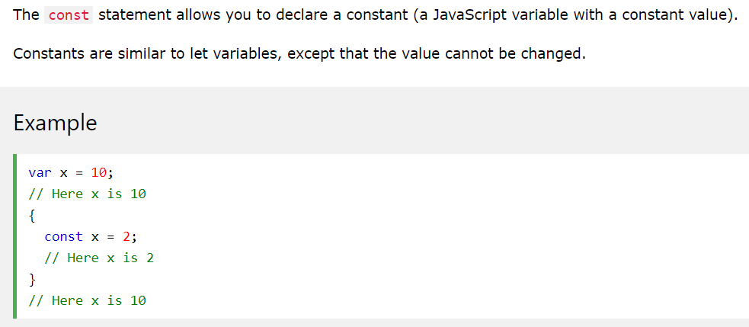
Variables - ECMAScript 6

Slide 13
Primitive Data Types
JavaScript has dynamic types. This means that the same variable can be used as different types:
var x; // x is undefined var x = 5; // now x is a Number var x = "John"; // now x is a String
Variables may contain values of the following primitive types: Number, String, Boolean, Null
Numbers are not allowed as the first character of identifiers
Joining words: firstName, lastName, masterCard, interCity

Slide 14
Numbers
JavaScript Numbers can be written with or without decimals:
var x1 = 34.00;
var x2 = 34;
The Number.isInteger() method returns true if the argument is an integer:
Number.isInteger(10); // returns true
Number.isInteger(10.5); // returns false
The isNaN() method returns true if the argument is not a Number.
Extra large or extra small numbers can be written with scientific (exponential) notation:
var y=123e5; // 12300000
var z=123e-5; // 0.00123
The exponentiation operator (**) raises the first operand to the power of the second operand:
var x = 5;
var z = x ** 2; // result is 25
// x ** y produces the same result as Math.pow(x,y):

Slide 15
Strings
A string can be any text inside quotes. You can use single or double quotes:
var carname="Volvo XC60"; var carname='Volvo XC60';
You can use quotes inside a string, as long as they don't match the quotes surrounding the string:
var answer="It's alright"; var answer="He is called 'Johnny'"; var answer='He is called "Johnny"';

Slide 16
Boolean
Booleans can only have two values: true or false.
var x = true; var y = false;

Slide 17
Undefined and Null
Undefined is the value of a variable with no value.
Variables can be emptied by setting the value to null;
cars = null;

Slide 18
== vs ===
equality operator ==, the interpreter implicitly tries to convert the values before comparing them
function myFunction(){
var x = 5;
document.getElementById("demo").innerHTML = x=="5"; //returns true
}
identity operator ===, does not convert the values when comparing them
function myFunction(){
var x = 5;
document.getElementById("demo").innerHTML = x==="5"; //returns false
}

Slide 19
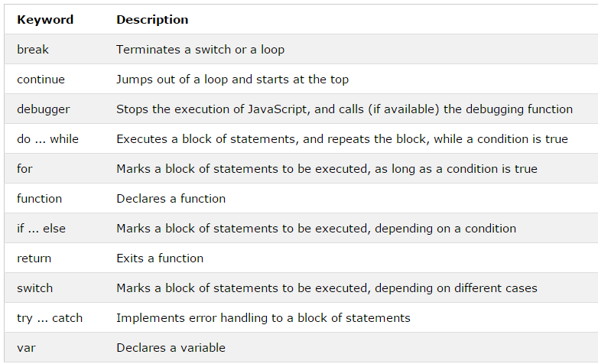
Keywords
Notes:
Also: “this”, next lecture

Slide 20
Functions and Events
<script>
document.getElementById("demo").innerHTML="My First JavaScript";
</script>
The code above is executed when the page loads
More often, we want to execute code when an event occurs, like when the user clicks a button
If we put JavaScript code inside a function, we can call that function when an event occurs

Slide 21
Functions
A function is a block of code that will be executed when "someone" calls it.
It is written as a code block (inside curly { } brackets), preceded by the function keyword.
<!DOCTYPE html> <html> <head> <script> function myFunction(){ alert("Hello World!"); } </script> </head> <body> <button onclick="myFunction()">Try it</button> </body> </html>

Slide 22
Functions with Arguments
A function in JavaScript is always passed by value, just like the primitive types
<button onclick="myFunction('Bob', 'Builder')">Click for Bob</button>
<script>
function myFunction(name, job){ // note we don’t use “var name”
alert("Welcome " + name + ", the " + job);
}
</script>
ES6 allows function parameters to have default values
function myFunction(x, y = 10) { // y is 10 if not passed or undefined return x + y; }
myFunction(5); // will return 15

Slide 23
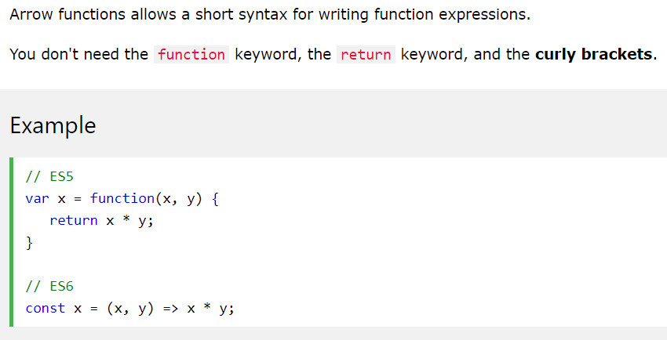
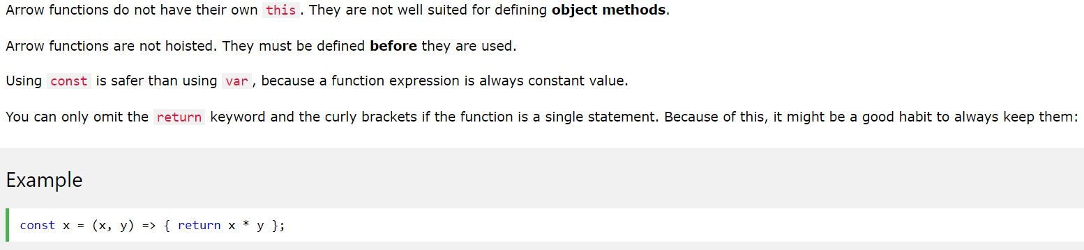
Arrow Functions
https://www.w3schools.com/js/js_arrow_function.asp

Slide 24
Event Handlers
An event handler is a predefined JavaScript property of an object (in most cases an element in the document) that is used to handle an event on a Web page.
An event is something that happens when the viewer performs some sort of action, such as clicking a mouse button, moving the mouse over a link, etc.
The page loading or other similar actions are also events.
JavaScript event handlers identify them and perform specific tasks, making pages interactive and more useful.

Slide 25
Event in HTML Element
To use an event handler, you add it as an additional attribute to an HTML tag.
The only difference between an event handler “attribute” and an HTML attribute is that you can add JavaScript code inside an event handler attribute rather than just an attribute value:
<body>
<form>
<input type = "button" value = "Click Me!" onclick = "window.alert('Hi!');">
</form>
</body>
Notice that the alert command ends with a semicolon.
This enables you to add additional JavaScript code after the alert, to perform multiple actions on the click event.

Slide 26
Event in HTML Element
If the code you want to use is long, you may wish to put it in a function
That function can be in an external file as well
function hi_and_bye() {
alert('Hi!');
alert('Bye!');
}
…
<body>
<form>
<input type = "button" value = "Click Me!" onclick = "hi_and_bye();" />
</form>
<script src=“ext1.js"></script>
</body>

Slide 27
Event Handler in the Script Code
You can also tie an event to the element within the script code, with document.getElementById(), for example.
<body>
<form>
<input type = "button" value = "Click Me!" id = "say_hi">
</form>
<script>
function hi_and_bye() {
alert('Hi!');
alert('Bye!');
}
var hi_button = document.getElementById("say_hi");
hi_button.onclick = hi_and_bye;
// if you use hi_and_bye(); above, the function will be called straight away
</script>
</body>

Slide 28
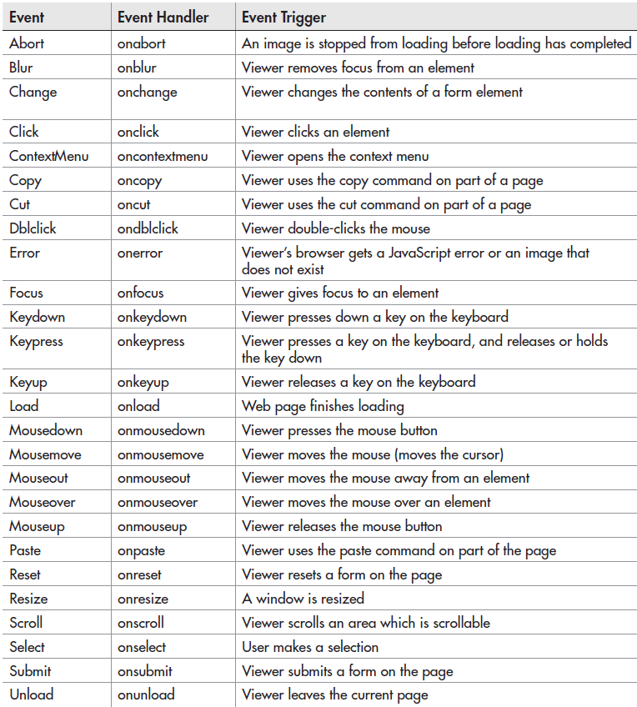

Slide 29
Example: onmouseover
<!DOCTYPE html>
<html>
<body>
<div onmouseover = "mOver(this);" onmouseout = "mOut(this);">Mouse Over Me</div>
<!-- you are passing the div to the function -->
<script>
function mOver(obj){
obj.innerHTML = "Thank You";
}
function mOut(obj){
obj.innerHTML = "Mouse Over Me, Please!";
}
</script>
</body>
</html>

Slide 30
Example: onmousedown, onmouseup
<!DOCTYPE html>
<html>
<body>
<div onmousedown = "mDown(this);" onmouseup = "mUp(this);" style = "background-color:#D94A38;width:90px;height:20px;padding:40px;">Click Me</div>
<script>
function mDown(obj){
obj.style.backgroundColor = "#1ec5e5";
obj.innerHTML = "Release Me!";
}
function mUp(obj){
obj.style.backgroundColor = "#D94A38";
obj.innerHTML = "Thank You!";
}
</script>
</body>
</html>

Slide 31
Timing Events
JavaScript allows for the execution of code at specified time intervals - timing events:
setTimeout(function, milliseconds)
// executes a function, after waiting a specified number of milliseconds
setInterval(function, milliseconds)
// same as setTimeout(), but repeats the execution of the function continuously
clearTimeout(var)
// stops the execution of the function specified in setTimeout(), saved into a //variable
clearInterval(var)
// stops the executions of the function specified in the setInterval() method
<button onclick="myVar = setTimeout(myFunction, 3000)">Try it</button> <button onclick="clearTimeout(myVar)">Stop it</button>

Slide 32
Example: setInterval()
Pop up an alert every 2 seconds (2000 milliseconds):
<html>
<head>
</head>
<body>
<script>
function annoy_alert() {
alert("Am I bothering you yet?");
}
setInterval(annoy_alert, 2000);
// setInterval(“annoy_alert()”, 2000);
</script>
</body>
</html>
Notes:
Notice the syntax!

Slide 33
Objects
In JavaScript almost everything is an object.
Even primitive datatypes (except null and undefined) can be treated as objects.
Booleans, Numbers, Strings can be objects or primitive data treated as objects.
Dates are always objects.
Maths and Regular Expressions are always objects.
Arrays are always objects.
Even functions are always objects.

Slide 34
Object Properties
Properties are the values associated with an object.
The syntax for accessing the property of an object is:
objectName.propertyName
This example uses the length property of the String object to find the length of a string:
var message = "Hello World!"; var x = message.length;
The value of x, after execution of the code above will be 12

Slide 35
Objects Methods
Methods are the actions that can be performed on objects.
You can call a method with the following syntax:
objectName.methodName()
This example uses the toUpperCase() method of the String object, to convert a text to uppercase:
var message = "Hello world!"; var x = message.toUpperCase();
The value of x, after execution of the code above will be
HELLO WORLD!

Slide 36
Classes
<!DOCTYPE html>
<html>
<body>
<script>
class Person{
constructor (firstname, lastname, age, eyecolor){
this.firstname = firstname;
this.lastname = lastname;
this.age = age;
this.eyecolor = eyecolor;
}
}
var myFriend = new Person("John","Doe",50,"blue");
document.write(myFriend.firstname + " is " + myFriend.age + " years old.");
</script>
</body>
</html>

Slide 37
“this” keyword
In JavaScript, the thing called this, is the object that "owns" the JavaScript code.
The value of this, when used in a function, is the object that "owns" the function.
The value of this, when used in an object, is the object itself.
Note that this is not a variable. It is a keyword. You cannot change the value of this.

Slide 38
Creating a Direct Instance
The following examples create a new instance of an object, with four properties in it:
var person = { firstName: "John", lastName: "Doe", age: 50, eyeColor: "blue" };
var person = {firstName:"John", lastName:"Doe", age:50, eyeColor:"blue"};

Slide 39
Adding Properties to Objects
You can add new properties to an existing object by simply giving it a value.
Assume that the person object already exists - you can then give it new properties:
var person2 = {};
(…)
person2.hairColour = "black";

Slide 40
Arrays
A JavaScript array should be created with []:
var myCars = ["Saab", "Volvo", "BMW"];
Accessing:
var name = cars[0];
// Array indexes start with 0
// In JavaScript, arrays always use numbered indexes.

Slide 41
Array Elements Can Be Objects
JavaScript variables can be objects. Arrays are special kinds of objects, with numbered indexes.
Because of this, you can have variables of different types in the same Array.
You can have objects in an Array. You can have functions in an Array. You can have arrays in an Array:
myArray[0] = Date.now; myArray[1] = myFunction; myArray[2] = myCars;

Slide 42
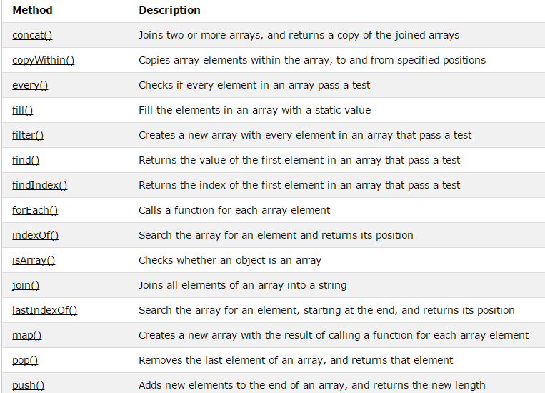
Array Properties and Methods
https://www.w3schools.com/jsref/jsref_obj_array.asp

Slide 43
Arrays versus Objects
Arrays use numbered indexes.
Objects use named indexes.
Arrays are a special kind of objects, with numbered indexes.
When to Use Arrays? When to use Objects?
JavaScript does not support associative arrays (maps, dictionaries)
You should use objects when you want the element names to be strings (text).
You should use arrays when you want the element names to be numbers.

Slide 44
Passing Objects as Arguments
JavaScript is always passed by value, but for objects that value of the variable is a reference.
Because of this, when you pass an object and change its properties, those changes persist outside of the function.
This makes it look like it’s pass by reference.
But if you actually change the value of the object variable, you will see that the change does not persist, proving it's really pass by value.

Slide 45
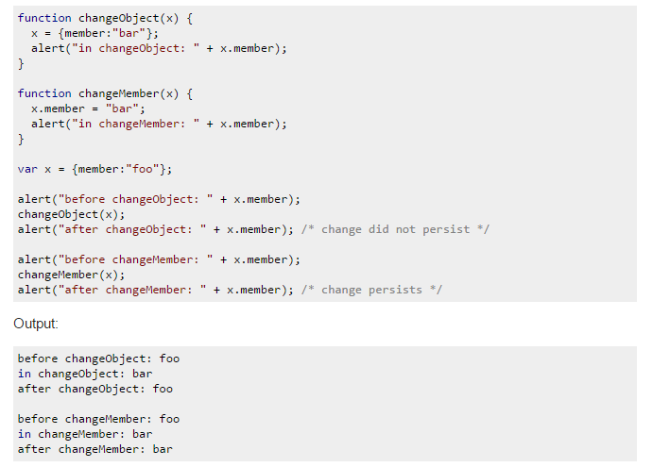
Passing Objects as Arguments

Slide 46
JavaScript for...in Loop
The code inside the for...in loop will be executed once for each property of the object:
<p>Click the button to loop through the properties of an object named "person".</p>
<button onclick = "myFunction()">Try it</button>
<p id = "demo"></p>
<script>
function myFunction(){
var txt = "";
var person = { fname:"John", lname:"Doe", age:25 };
for (var x in person){
txt = txt + " " + person[x];
}
document.getElementById("demo").innerHTML = txt;
}
</script>

Slide 47
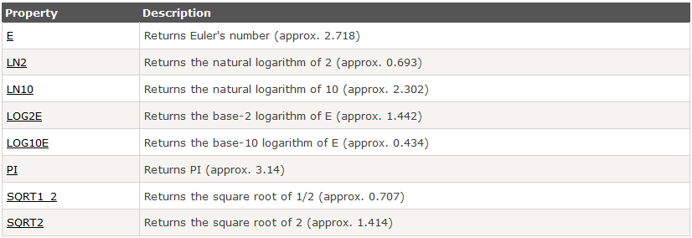
Math Object Properties
The Math object allows you to perform mathematical tasks.
All properties/methods of Math can be called by using Math as an object, without creating it, e.g. Math.PI

Slide 48
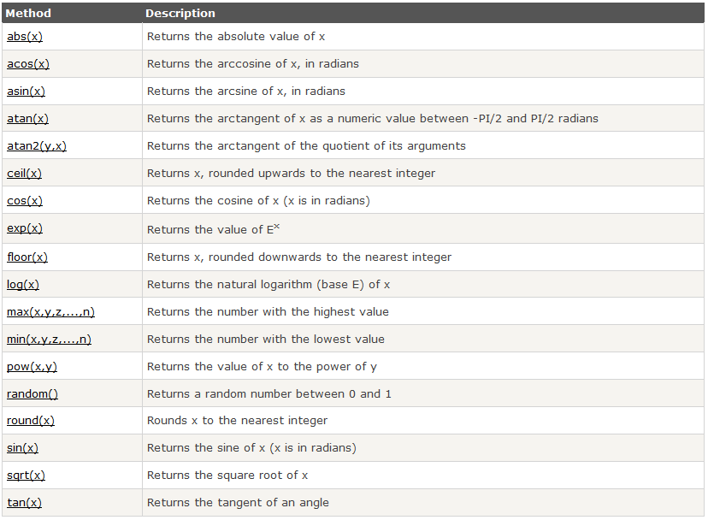
Math Object Methods

Slide 49
Date Object
new Date() creates a new date object with the current date an time
new Date(year, month, day, hours, minutes, seconds, milliseconds)
Note: JavaScript counts months from 0 to 11.
January is 0. December is 11.
new Date(milliseconds)
milliseconds since January 01, 1970, 00:00:00 UTC
new Date(date string)
"2019-09-16" (The International Standard)

Slide 50
Window Object
The window object is supported by all browsers. It represents the browser's window.
All global JavaScript objects, functions, and variables automatically become members of the window object.
Even the document object (of the HTML DOM) is a property of the window object:
window.document.getElementById("header");
is the same as:
document.getElementById("header");

Slide 51
Window Popups
Alert Box
An alert box is often used if you want to make sure information comes through to the user.
When an alert box pops up, the user will have to click "OK" to proceed.
window.alert("sometext");
Confirm Box
A confirm box is often used if you want the user to verify or accept something.
When a confirm box pops up, the user will have to click either "OK" or "Cancel" to proceed.
If the user clicks "OK", the box returns true. If the user clicks "Cancel", the box returns false.
window.confirm("sometext");

Slide 52
Window Popups
Prompt Box
A prompt box is often used if you want the user to input a value before entering a page.
When a prompt box pops up, the user will have to click either "OK" or "Cancel" to proceed after entering an input value.
If the user clicks "OK" the box returns the input value. If the user clicks "Cancel" the box returns null.
window.prompt("sometext","defaultText");
All popups can be written without the window prefix
alert(), confirm(), prompt()
To display line breaks inside a popup box, use \n

Slide 53
Best Practices
Put all declarations at the top of each script or function
Initialize all variables when declaring them
Use semicolons to separate statements
Add white space to your script to make it more readable
put spaces around operators ( = + - * / )
Avoid code lines longer than 80 characters
If a JavaScript statement does not fit on one line, the best place to break it, is after an operator

Slide 54
Tips
You can use the console.log() method to display data
similar to System.out.println() in Java
Press F12 in the Browser window
Go to “console” to see the output
You can also use “Inspect Elements” to test code changes live
www.w3schools.com has documentation, examples and a “simulator”

